Slide 1
Graphics: Elements of Design
Objective 103.01

Slide 2
Elements of Design
Color
Line
Shape
Texture

Slide 3
Color
Helps identify objects in a design
Creates visual flow in a design
Communicates feelings and moods to the audience or viewer
Consists of hue, saturation, and brightness

Slide 4
Color can be used to convey specific emotions or moods…
RED – excitement, anger, danger, love
BLUE – calm, sadness, peacefulness
GREEN – envy, luck, quietness
YELLOW – weakness, sympathy, cheerfulness, happiness
ORANGE – liveliness, energy, warmth
PURPLE – royalty, respect, dignity, mystery
BLACK – mourning, despair, sophistication, intensity, intimidation
WHITE – innocence, purity, clean, faith

Slide 5
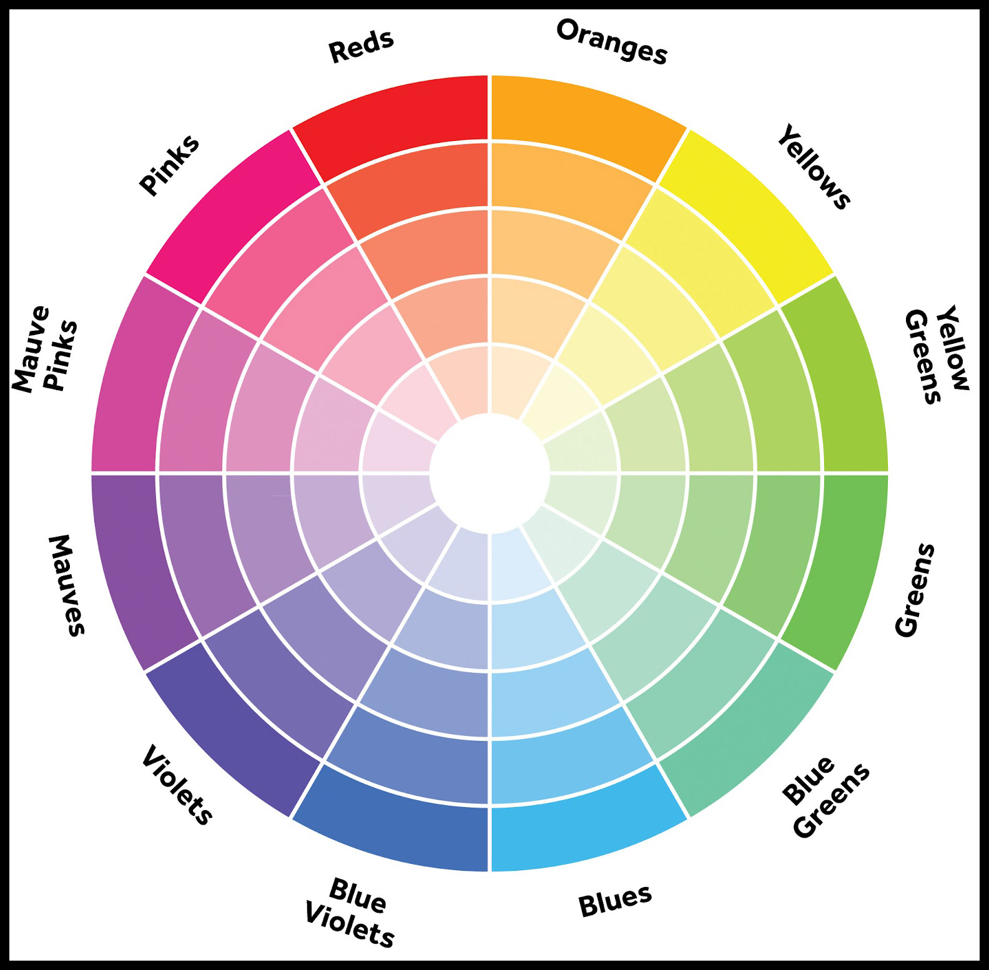
Colors across from each other on the color when work well together. These are called Complementary Colors.

Slide 6
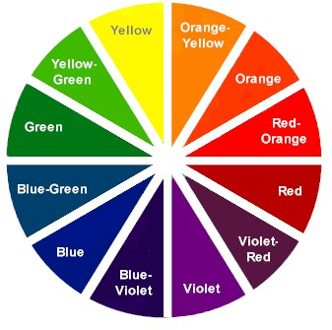
Hue – the given name to a color
Within a particular hue, a variety of individual colors can be created by changing the saturation and brightness

Slide 7
Saturation – the amount of hue used in a particular color

Slide 8
Brightness – how light or dark a color appears; adding black or white changes a color’s brightness (just think of mixing paint)

Slide 9
Lines
Give direction to design
Create movement in a design
Thick lines show importance, thin lines, demonstrate quick movement
Could be vertical, horizontal, diagonal, or curved lines

Slide 10
Lines

Slide 11
Shapes
Can be used to bring special emphasis to text or a graphic
The form of an object
When lines enclose a space
Can be used to help identify object
Example: circle=sun, oval = egg
Three basic shapes:
Circle, triangle, square

Slide 12
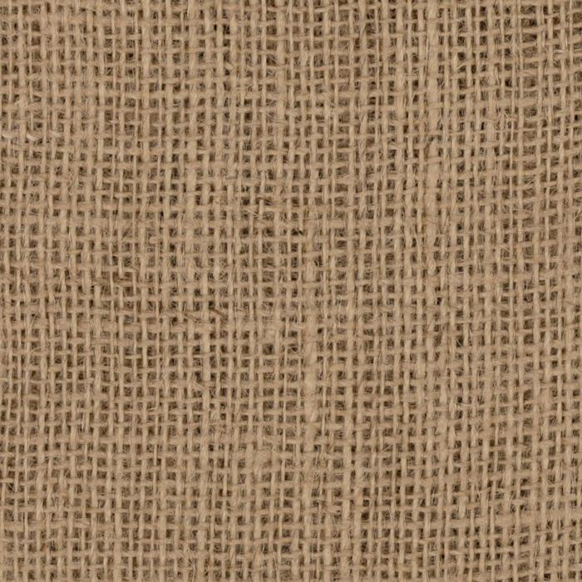
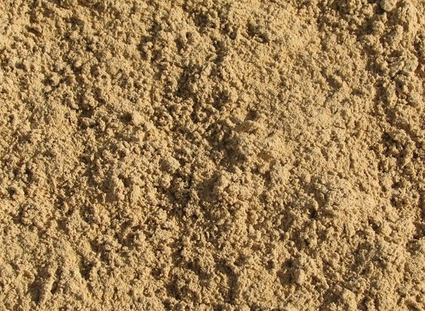
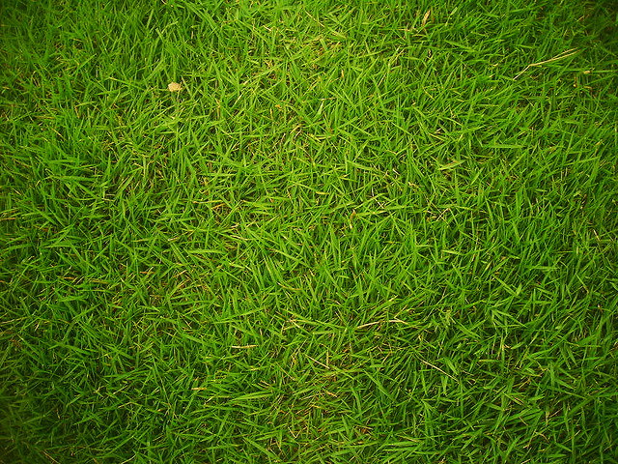
Texture
Adds depth and dimension to a design

