Slide 1
Understand the core concepts of Digital Media
Objective 101.01

Slide 2
Media
Messages aimed at mass audiences; can be delivered in many form or methods

Slide 3
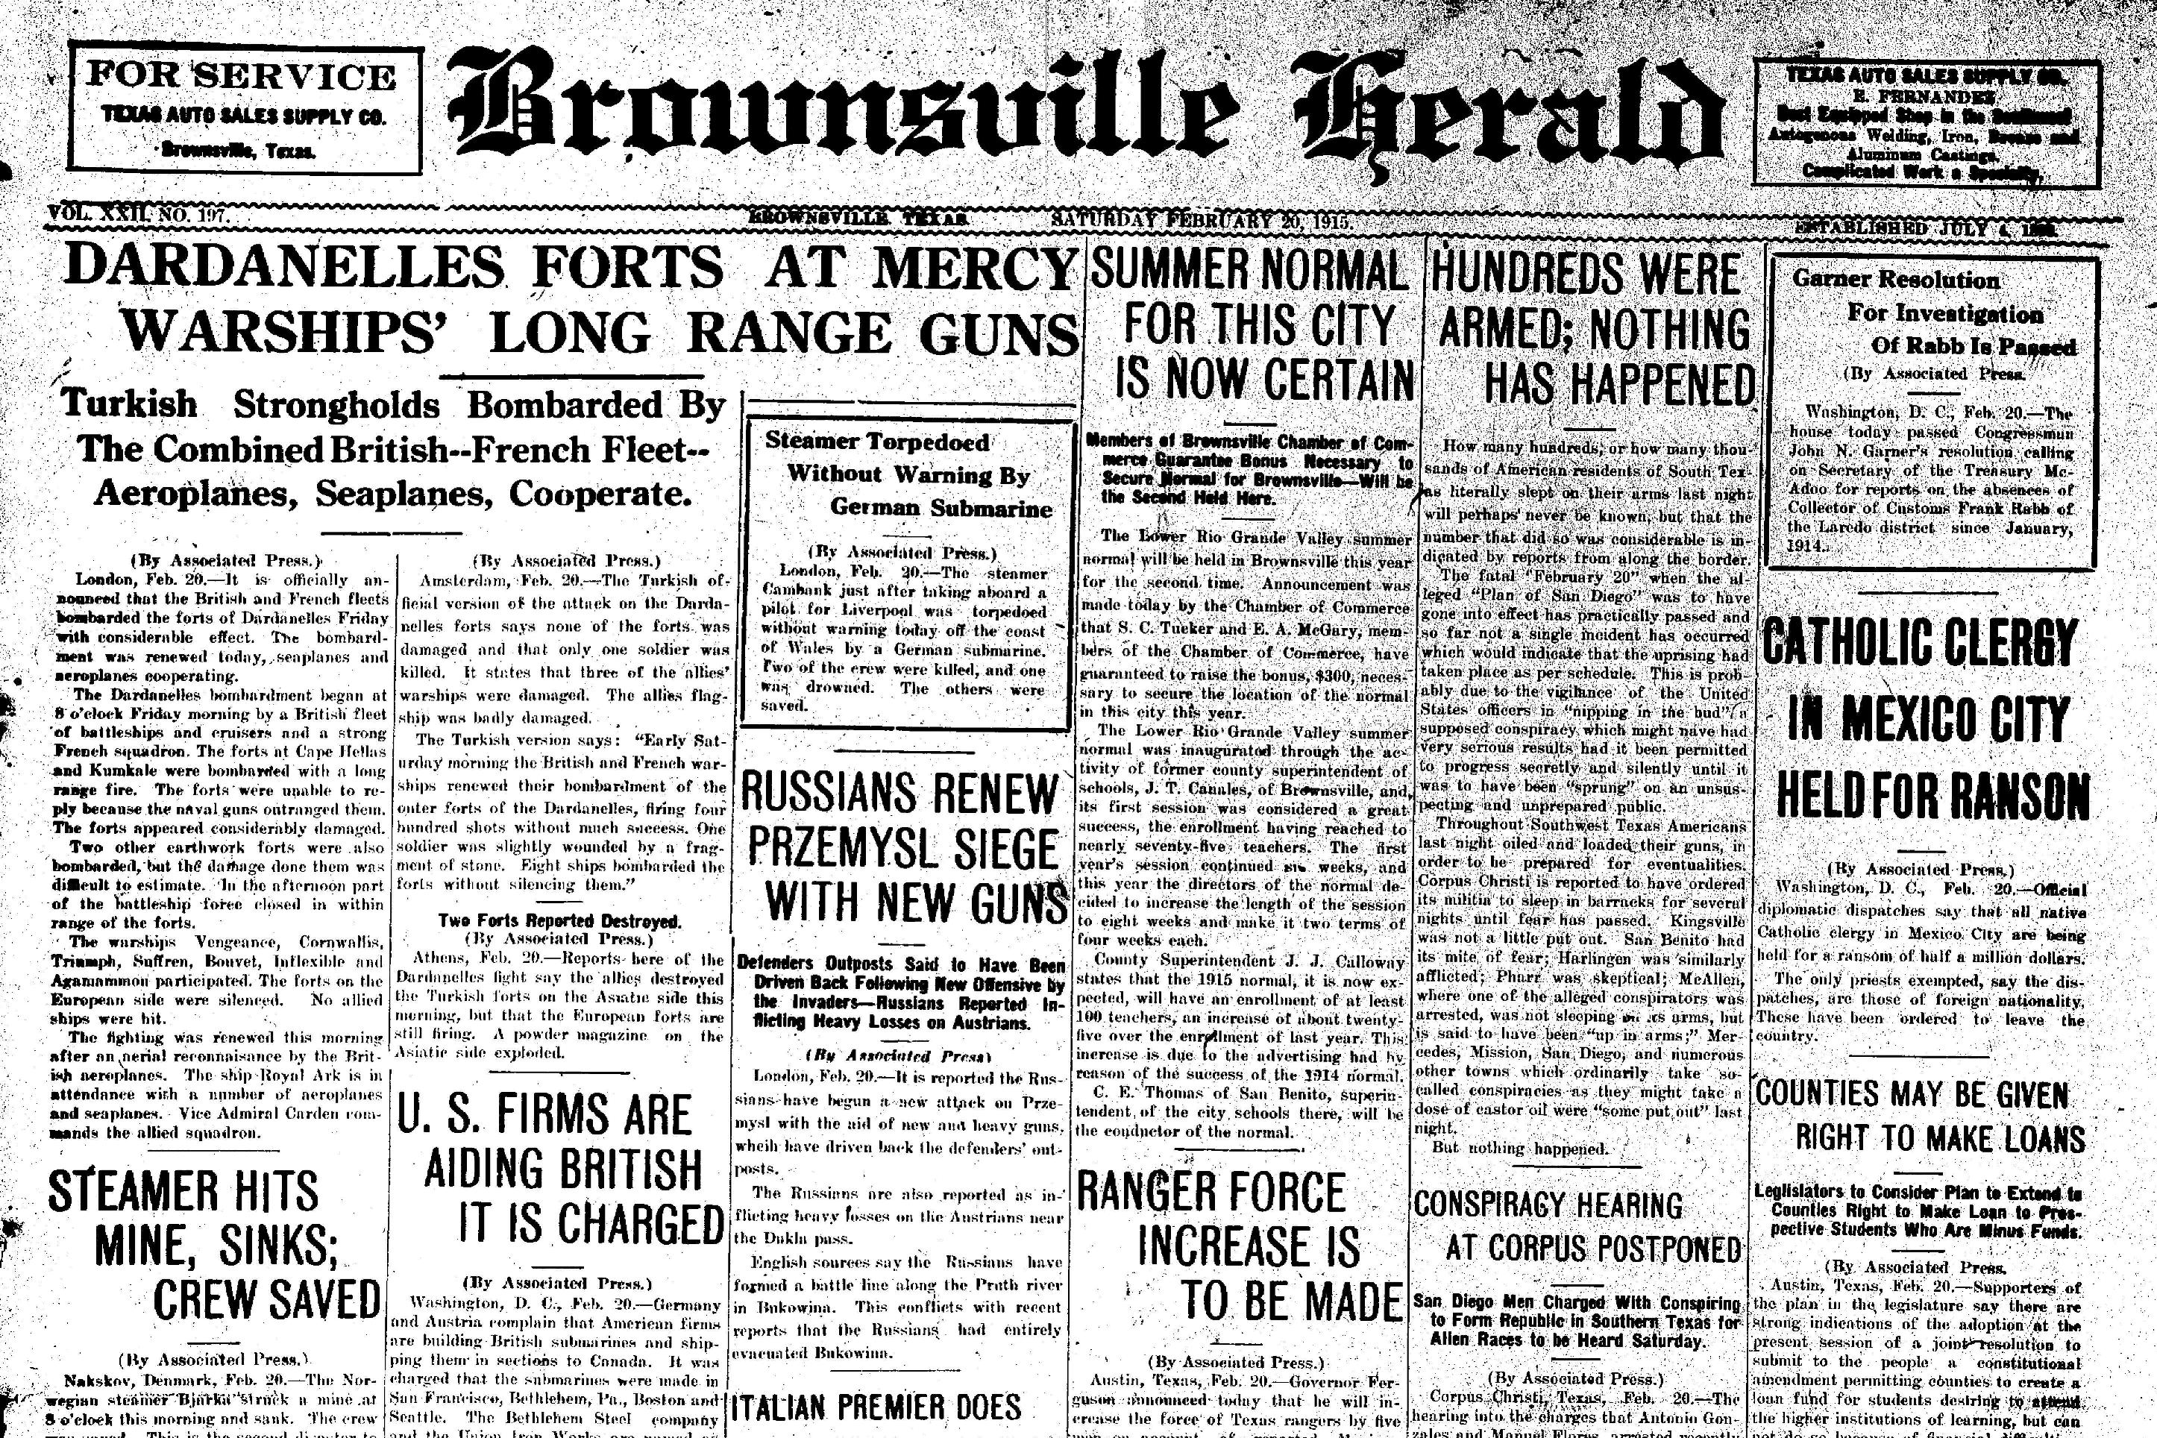
Communication that was well-established before the Internet age; Ex: books, newspapers, magazines, etc.
Traditional Media

Slide 4
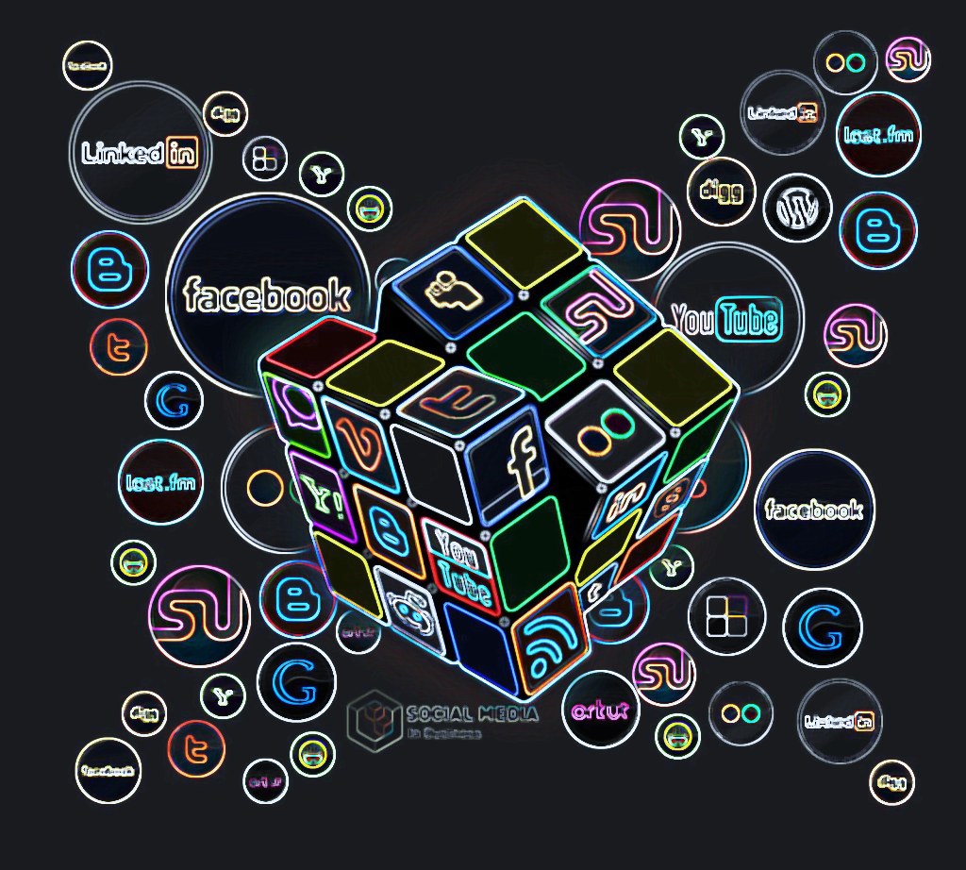
Created and controlled by a community of users that interact using the Internet; Ex: Facebook, Twitter, Instagram, YouTube
Social Media

Slide 5
The use of creative design and computer technology to combine forms of media to reach the audience in various ways
Digital Media

Slide 6
Traditional Media vs. Social Media vs. Digital Media
Effectiveness?
Design?
Cost?
Pros & Cons
What do you think?

Slide 7
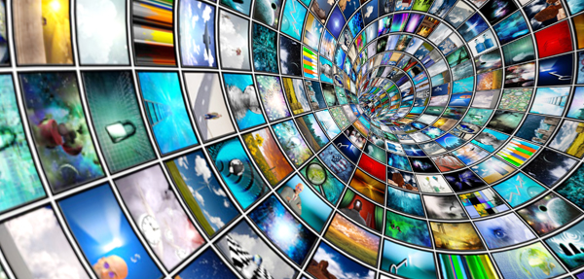
Digital Media
5 Major Categories
Graphic Design
Animation Development
Audio Production
Video Production
Web Design

Slide 8
How can Digital Media be used in education?

Slide 9
Digital Media Production
Pre-Production
Production
Post-Production
3 major phases of producing digital media

Slide 10
Defining the parameters of the project and making preliminary decisions about conveying the intended message to the audience
Pre-Production

Slide 11
The active process of using industry-standard software and hardware to create an original piece of digital media
Production

Slide 12
Modifying the project to accomplish the intended purpose; optimizing the output file to meet client’s specific needs
Post-Production

