Slide 1
Digital Media and Society
101.02

Slide 2
Commercial
Persuade audience to use / buy a product
Commercials
Advertisements

Slide 3
Entertainment
Captivate an audience and keep them engaged
Digital art
Movies
Video games
Music

Slide 4
News / Informational
Informs audience about recent events / topics
News casts
Online periodicals

Slide 5
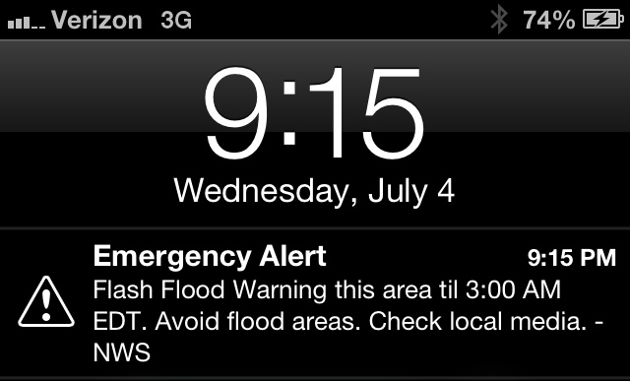
Public Service Announcement (PSA)
Conveys important message to the public (no specific audience)
Encourages public to take action or further education themselves

Slide 6
Educational
Interactively teach content or demonstrate a process
Online tutorials
Descriptive animations

Slide 7
How can experience in digital media relate to the professional world?

