Slide 1
Graphics: Principles of Design
Objective 103.01

Slide 2
The Principles of Design
Proportion
Balance
Rhythm
Emphasis
Unity / Harmony

Slide 3
Proportion
A size relationship between components of a design
Can be:
Between one component of a design and another component
Between a component and the whole design

Slide 4
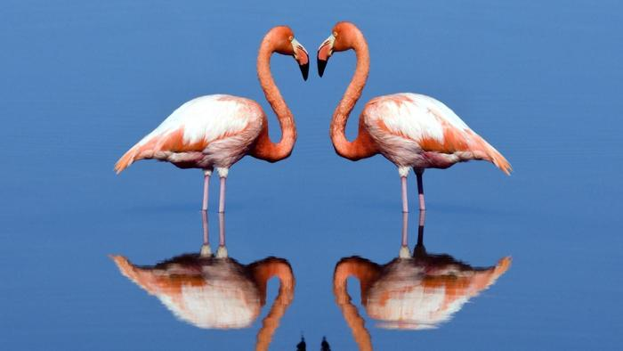
Balance: how design elements are arranged either horizontally or vertically on the canvas
Formal Balance
Informal Balance
Known as symmetrical balance
Design is exactly equal on both sides
Known as asymmetrical balance
Both sides of the design are not equal, but are still balanced

Slide 5
Rhythm
Creating the feeling of movement in a design
Generated through the reputation of lines, colors, shapes, and textures
Consistency

Slide 6
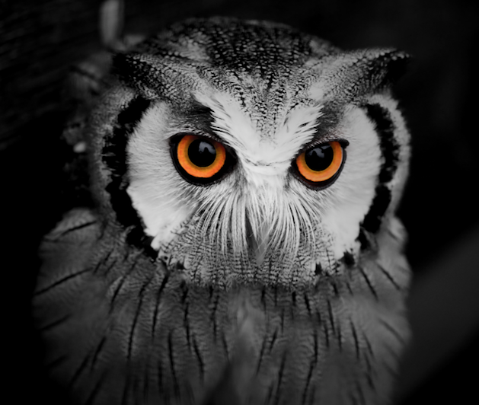
Emphasis
Center of interest in a design
Component of the design that is noticed first by the audience
Can create visual flow in a design

Slide 7
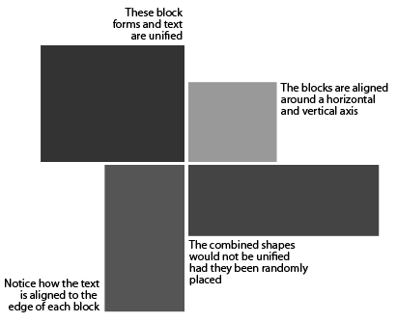
Unit / Harmony
When all components of a design look as if they belong together
Achieved when the Elements and Principles of Design are used effectively

