Slide 1
Understanding Web-Based Digital Media Production Methods, Software, and Hardware
Objective 107.02

Slide 2
Three Phases for Designing Web-Based Digital Media
Pre-Production
Production
Post-Production

Slide 3
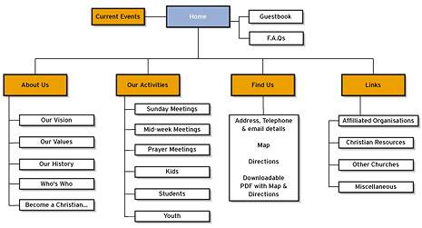
Pre-Production
Determine the purpose
Determine the target audience
Use a flowchart to
determine specific
pages of a website
and how they will
be organized and
linked together

Slide 4
Pre-Production (continued)
Determine hardware needs
Computer
External Server
Used to host website
Make it accessible by the Internet users
Internet Connection
For transferring website to external server

Slide 5
Pre-Production (continued)
Determine software needs
W.Y.S.I.W.Y.G. (What you see is what you get)
Design software that manipulates components of the webpage without the user writing or editing code – also known as a Visual Editor
Text Editor
Simple text editing program used to write or edit web design code; does not show a visual
Determine appropriate web design language(s)

Slide 6
Pre-Production (continued)
Common Web Design Languages:
HTML
Basic framework for all web design
Written using “tags” that a web browser uses to interpret the code and generate the content on the webpage
Tags denote structured elements like headings, paragraphs, lists, etc.

Slide 7
Pre-Production (continued)
Common Web Design Languages:
CSS
Separates layout and design features (color scheme, fonts, menu styles, etc.) from the actual content of the website
Easiest way to make site-wide design changes
CSS file combines with HTML file to create a complete website
Common format of downloadable templates found on the Internet
JavaScript
Client-side web development
Creates standalone computer programs that run entirely on the user’s machine, which is quicker and more secure

Slide 8
Pre-Production (continued)
Common Web Design Languages:
PHP
Server-side web development
Connects an HTML file to a database of information on an external server
Creates dynamic websites with enhanced user interactivity
Flash
Uses Adobe Flash software interface to create websites
Commonly used to create Internet games and advertisements
Animation, audio, and video capability allow for enhanced design features

Slide 9
Production
Setup root folder for entire website
Create wireframe for each webpage
Add content to specific pages
Create hyperlinks between pages and out to external websites

Slide 10
Production (continued)
Web Deign Terms:
Root Folder – a central location of storage for every file involved in designing a website; allows the website to be portable from computer to computer
Wireframe (Skeleton)
A visual guide to how a web page content will be organized; assists in the arrangement and scaling of design components
Template
A pre-determined wireframe that can be quickly downloaded and utilized
Graphics Optimization
Designing and exporting graphics with the specific purpose of using it on a website; allows for quicker loading times

Slide 11
Production (continued)
Web Deign Terms:
Alternative Text – textual descriptions of graphics and other design components on a web page; aids in search engine optimization
Image Map – a single graphic that is divided into sections and linked to different locations
Rollover – feature that indicates interactivity to the user; normally causes a component of a web page to visually change when the user’s cursor hovers over it
Web Form – an interactive feature that allows a user to submit information

Slide 12
Post-Production
Web Deign Terms:
Proof / Preview the hyperlinks for quality assurance
Troubleshoot any errors found during proofing
Check compatibility with a wide variety of web browsers to ensure consistency
Publish the finished website to a server so it can be accessed by Internet users

