Slide 1
Graphics: Concepts of Digital Graphics
Objective 103.01

Slide 2
Digital Graphics any image or design created or edited by a computer
Drawings
Logos
Photos
Advertising
Buttons
Icons
Diagrams
Charts

Slide 3
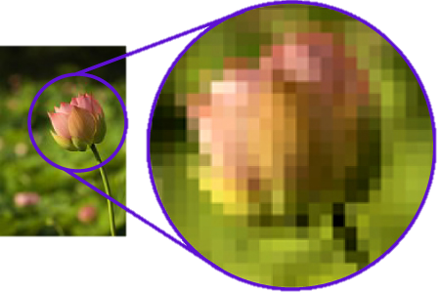
Bitmap Graphics
Vector Graphics
Use square pixels arranged in a grid that have assigned colors
Lose clarity when view up close or zoomed in
Also referred to as Raster Graphics
Use mathematical formulas to define lines, points, curves, and other attributes
Do not lose clarity when viewed up close or zoomed in
Best type of graphic for printing in large scale

Slide 4
Resolution describes the clarity of Bitmap Graphics; Determined by the number of Pixels per inch (PPI)
Low Resolution
High Resolution
Blurry in appearance
Relatively small file size
Very clear in appearance
Relatively large file size

Slide 5
Color Modes of Digital Graphics

Slide 6
Black & White
Uses only true black and true white

Slide 7
Grayscale
Uses true black, true white, and all shades of gray in between

Slide 8
True color
All possible color combinations

Slide 9
RGB (Red, green, blue)
Optimized for viewing on a screen

Slide 10
CYMK (Cyan, Yellow, Magenta, Black)
Optimized for printing purposes

Slide 11
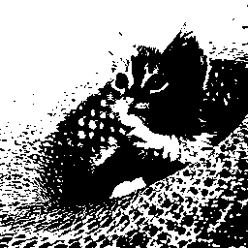
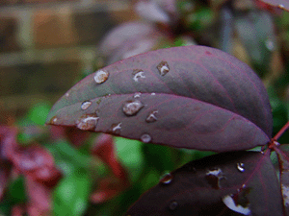
Color Depth
The number of distinct colors a graphic is capable of displaying
Related to color more
1-Bit: Black & White
8-Bit: Indexed Color (256 colors)
24-Bit: True Color
(16.7 million colors)

Slide 12
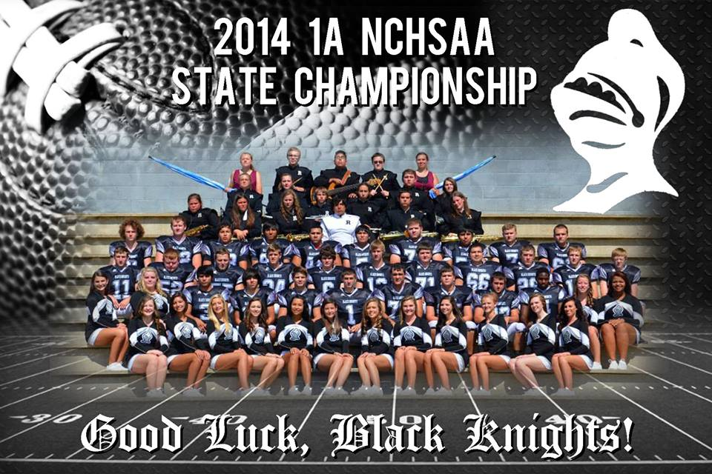
Layering (Layers in Photoshop)
Different levels in which you can place a image file or object
Flatten Layers = to compress or make all layers into one single layer

Slide 13
Other Photoshop Tools
Cropping
Quick Selection
Magic Eraser
Eraser
Blur
Red Eye Removal
Paint Bucket
Layer Properties
Transform
Adjustments Levels

