Slide 1
Safety Issues Associated with Digital Media
102.01

Slide 2
Physical Safety Issues
Electrical Hazards
Tripping Hazards
Ergonomics
When electrical connections used by digital media equipment are not handled properly, it could result in electric shock, burn, etc.
When pieces of digital media equipment and their connecting cables are not managed properly; could result in tripping hazard
Designing a workplace to best fit the worker, reducing strain on the body and enhancing comfort during digital media creation

Slide 3
Digital Safety Issues

Slide 4
Cyberbullying
Person is threatened, harassed, humiliated, tormented
Internet, Mobile Phones, etc.

Slide 5
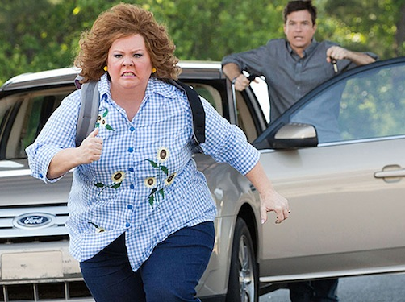
Identify Theft
Personal information Is stolen
Used to gain access to financial or personal accounts

Slide 6
Virus / Malware
Programs designed to damage a computer when installed
Can corrupt files, erase hard drive, access personal information

Slide 7
Spam
Unwanted emails
Advertise products
Promote services

Slide 8
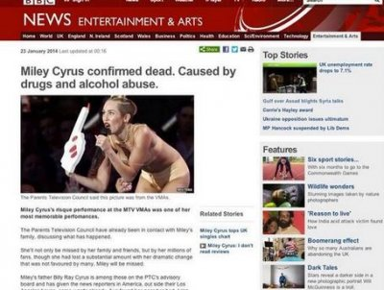
Online Hoax
False claim that is spread through electronic means

Slide 9
Internet Addiction
Compulsive disorder that causes unhealthy obsession with the Internet and other digital resources
Online Gambling
Social Media

